Slide 1
Watchdog project
Daher Mahagna
26.11.2020

Slide 2
Let me take care of your program

Slide 3
Sequence Diagram
SetUp sequence diagram
Ongoing Activity seauence diagram
end of WD seaquence diagram

Slide 4
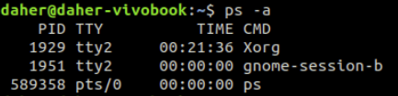
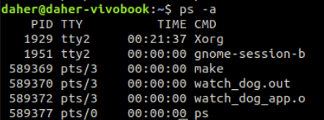
Running the main process
Before start the processes are not started to work
Start the main process
The when the user uses the start WD the WD process alse run

Slide 5
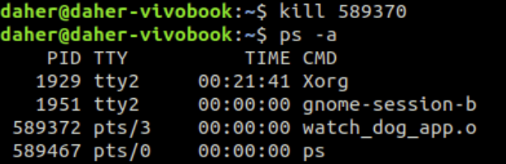
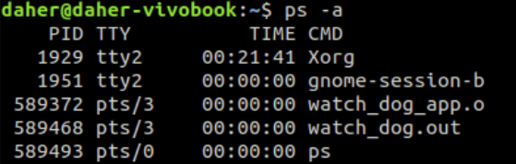
Playing with the WD
Lets start with killing the main process
The main process is stopped, and the WD process has to revive it
The main process is revived by the WD process with new PID

Slide 6
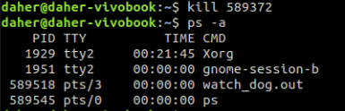
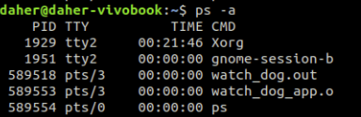
Playing with the WD – continue
Now lets try to kill the WD process
The WD process is stopped, and the main process has to revive it
The WD process is revived by the main process with new PID

Slide 7
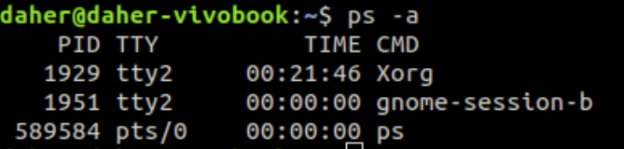

End of process
Both processes are stopped
The semaphores are freed.

Slide 8
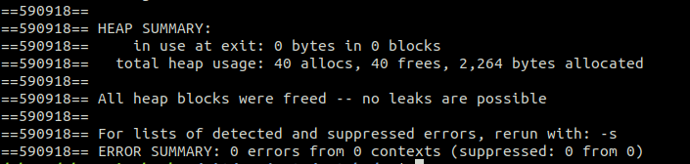
VLG test
And most important if the program has not stopped in the meddele
that all of the recources are freed.
* to make VLG test this is another run

Slide 9
Thank You :) !!

